Slide 1

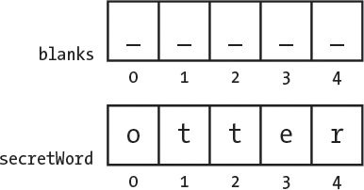
Hangman Game
The game displays a blank word and the player tries to guess it by suggesting letters within a certain number of guesses.
Project Coder:
Ronaldo Blanco

